Slide 1
NYC Public SCHOOLS: What can the college readiness index teach us?
Michelle Cronin
GA - DAT30
Final Presentation – March 16, 2016

Slide 2

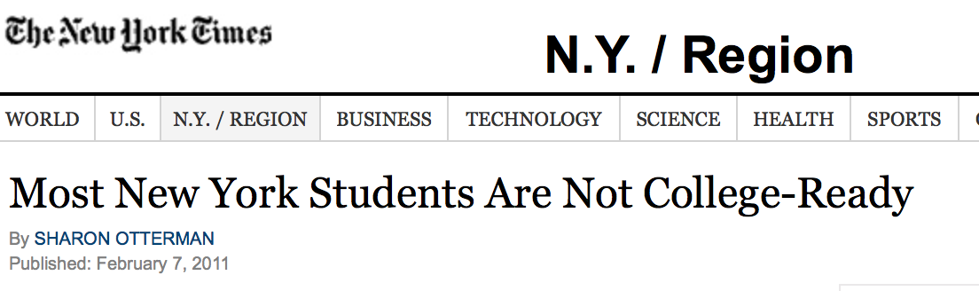
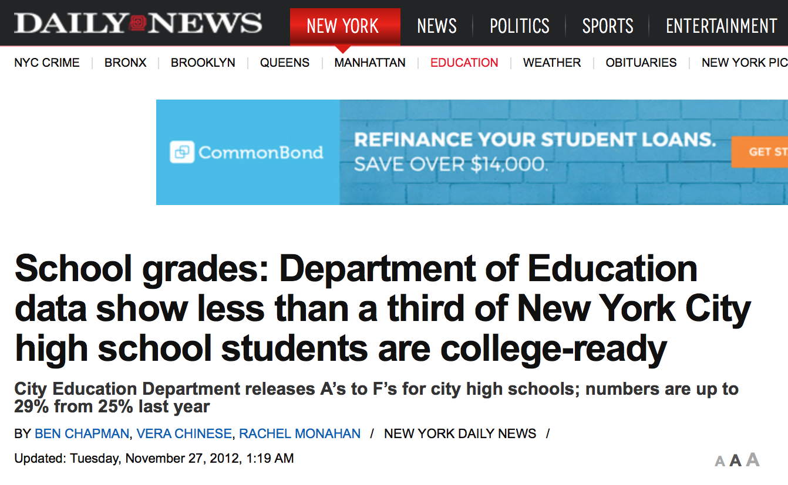
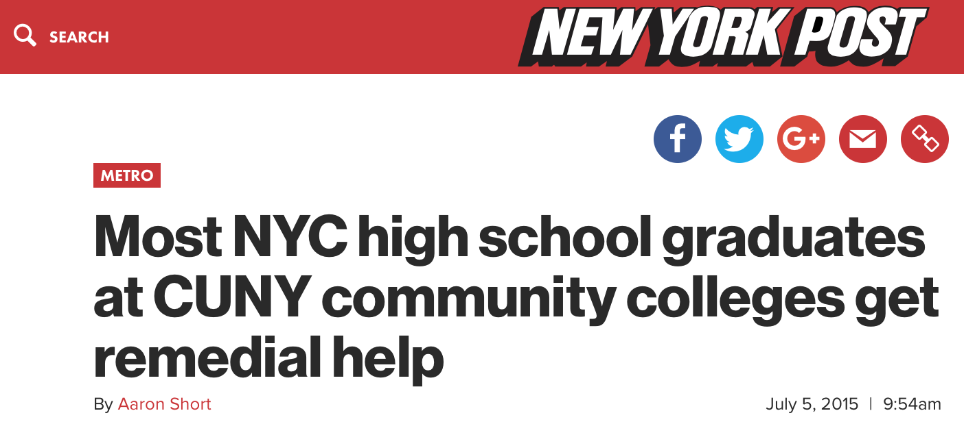
THE ISSUE
Although graduation rates in NYC public schools have risen over the years, the rate of students prepared for college has remained low (73% vs 29% on average, from my data)
Thus, NYC public schools are graduating many students each year who are not considered college-ready
QUESTION: Can we predict which schools are graduating college-ready students at a rate above NYC’s average graduation rate (within one standard deviation)? ← High-performing schools

Slide 3
Key Background Info ON THE DATA
Data gathered from NYC Open Data website and the NYC Department of Education website over past two school years
Ever since de Blasio administration changed school evaluation methods
Data summarizes schools – NOT info on individual students
College Readiness Index (CRI)
Percentage of students who meet CUNY's standards of readiness in math and English based on test scores (Regents, SATs, APs)
Derived cut-off scores based on students needing to enroll in remedial classes in CUNY community colleges (found boundary)
75% of enrollees in 2011¹
NYC public schools are some of the most racially and socioeconomically segregated schools in the nation²
¹ FODERARO, Lisa W. "CUNY Adjusts Amid Tide of Remedial Students." The New York Times, 3 Mar. 2011.
² Wong, Alia. "How to Solve the Diversity Problem at NYC's Public Schools." The Atlantic, 5 Mar. 2015.

Slide 4

Hypothesis
Schools with large populations of historically privileged groups will graduate students who are college-ready at a higher rate than schools with large amounts of populations that have been historically marginalized or have experienced structural inequalities.

Slide 5
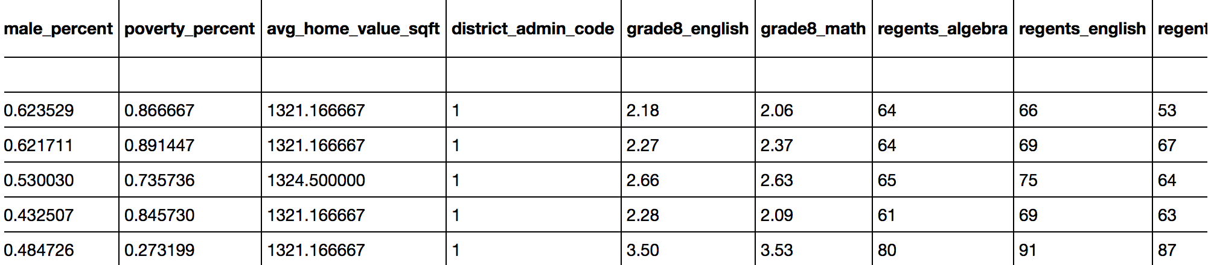
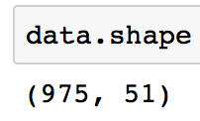
Peak at the Data
Mostly measurable characteristics of NYC public high schools (performance, demographics, location, etc.):
2013_2014_HS_SQR_Results_2015_03_02.xlsx
2014_2015_HS_SQR_Results_2016_01_07.xlsx
DemographicSnapshot201011to201415Public_FINAL-2.xlsx
2015 Graduation_Rates_Public_School-2.xlsx- DOE_High_School_Directory_2013-2014.csv
DOE_High_School_Directory_2014-2015.csv- 2014 Public Data File SUPPRESSED.xlsx
2015 Public Data File.xlsx- Location_Information_Report.csv
seven_major_felony_offenses_by_precinct_2000_2014.xls
violation-offenses-by-precinct_2000-2014.xls
Zip_MedianValuePerSqft_AllHomes.csv

Slide 6

Pre-processing
Dropped and imputed missing values
Feature Selection – Necessary due to overlapping features in sources as well as presence of irrelevant features
Feature Engineering:
Length of School Day (End of day – Start of day)
Diversity Score (Sum of the squared reported race/ethnicity percents [black, white, Hispanic, Asian]
Scaled since percent sums not always equal to 100%
.25 = Most Diversity | 1 = Least Diversity/Most Homogeny
Overall SAT score (Reading SAT + Writing SAT + Math SAT average scores)
Overall Regents score (Algebra + English + Living Environment + Global History Regents average scores)
Grade 8 Proficiency score (Grade 8 Math + Grade 8 English scores)
All Crime (Major crimes + violation offenses)
Tidied the names
Dummy categorization (separately)
Zip codes
Administrative Districts

Slide 7
Feature Selection
Created visuals to look at correlation (heatmap) → Removed highly correlated features (ex: many Regents exams)
Created visuals to view missing values → Removed those missing 50%+ (ex: pupil-teacher-ratio)
Viewed feature variance → removed those with lowest variance (ex: Public Service percentage attendance)
In the end, removed features directly related to the response variable due to leakage
Graduation Rate
College-Readiness Index (CRI) (and the highly-correlated college and career readiness index)
Test scores related to the CRI: all SAT scores, all Regents values, percentage of students scoring 3+ on AP exam
Also removed forward-looking features (post-secondary enrollment rate and related indicators)
Created four different datasets for modeling:
DataFrame Name | Description | Number of Features
data_noexam | Base | 30
data_admin | Contains administrative district codes + base | 63
data_zip | Contains zip codes + base | 151
data_rses | Contains only features directly related to hypothesis | 12

Slide 8

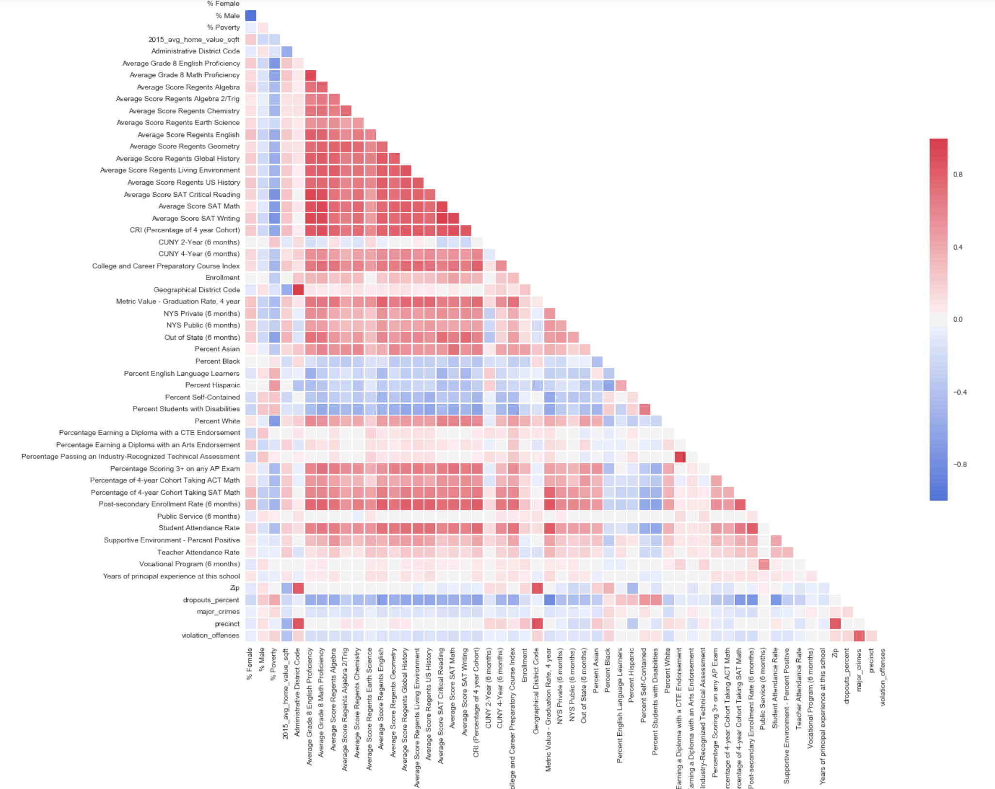
Observations
High school’s graduation rate and college readiness index share high correlation with the following features (in varying strengths):
Post-Secondary enrollment rate
Student Attendance Rate
Percentage of students who take the SAT
Grade 8 Proficiency Scores
Poverty and Disability (Negatively correlated)

Slide 9
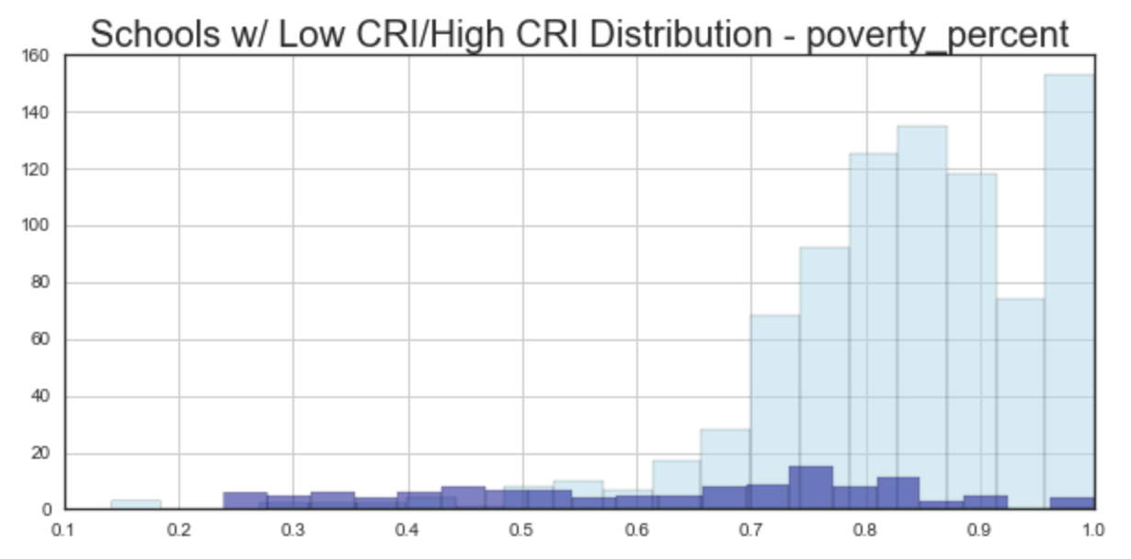
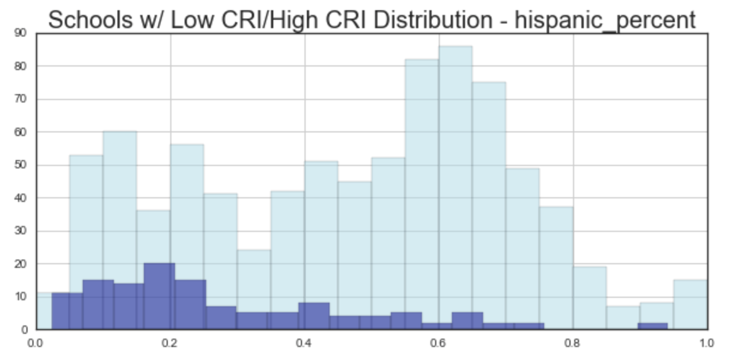
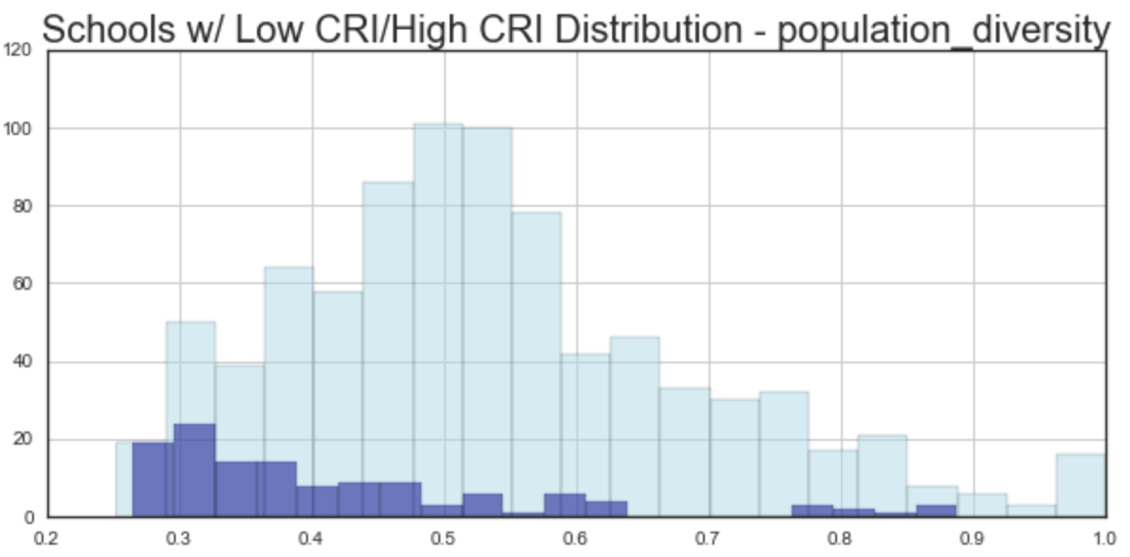
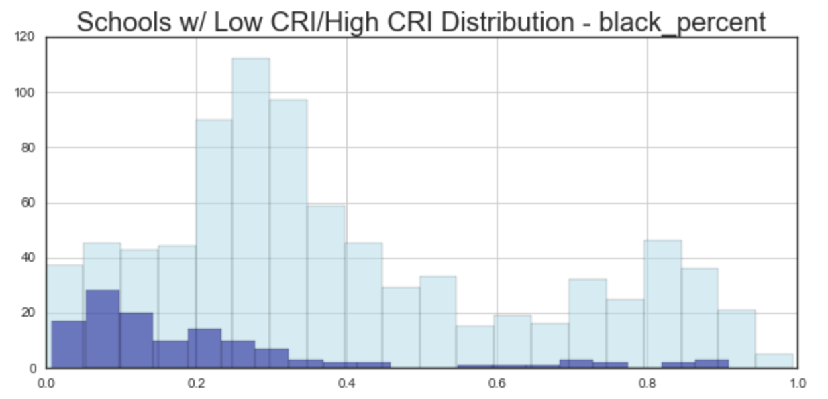
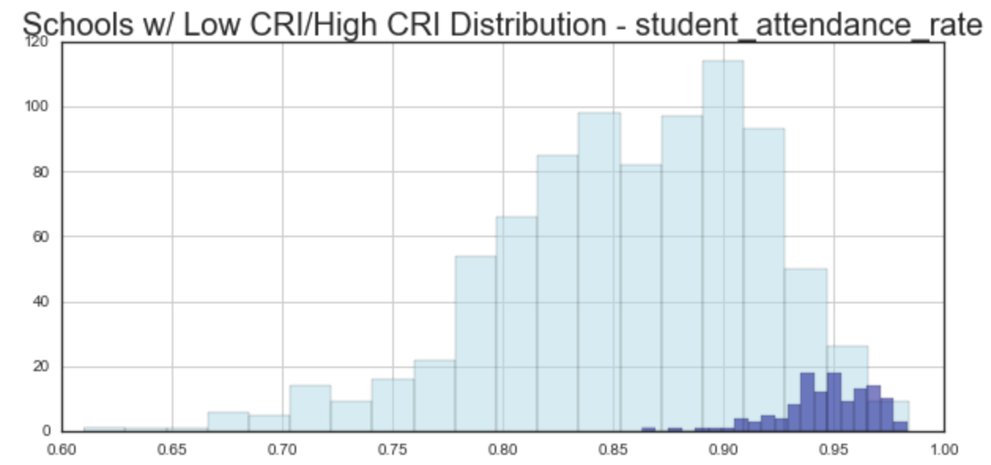
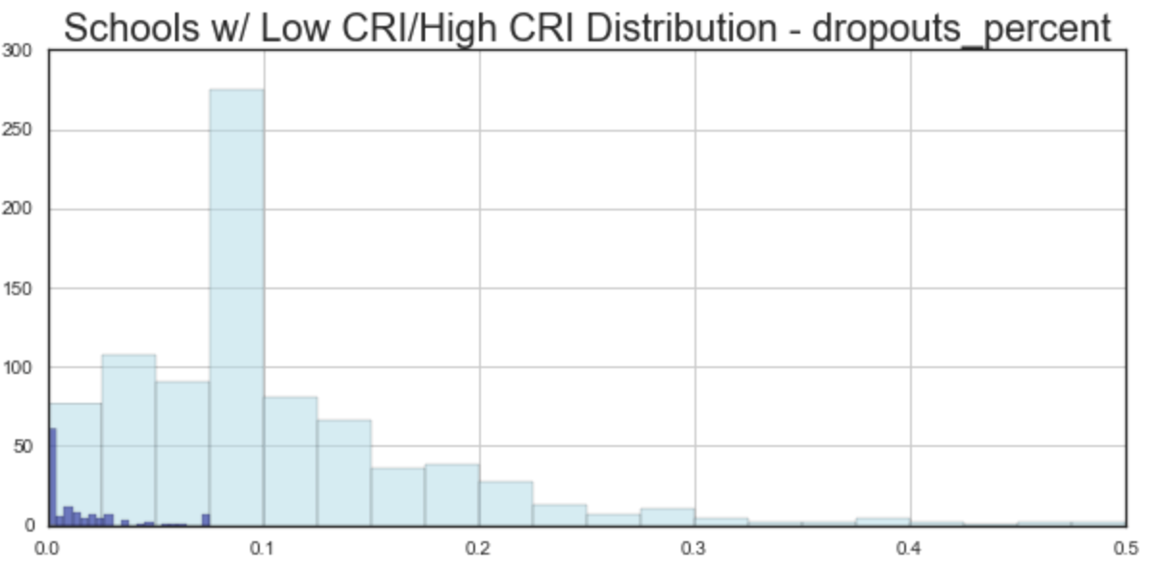
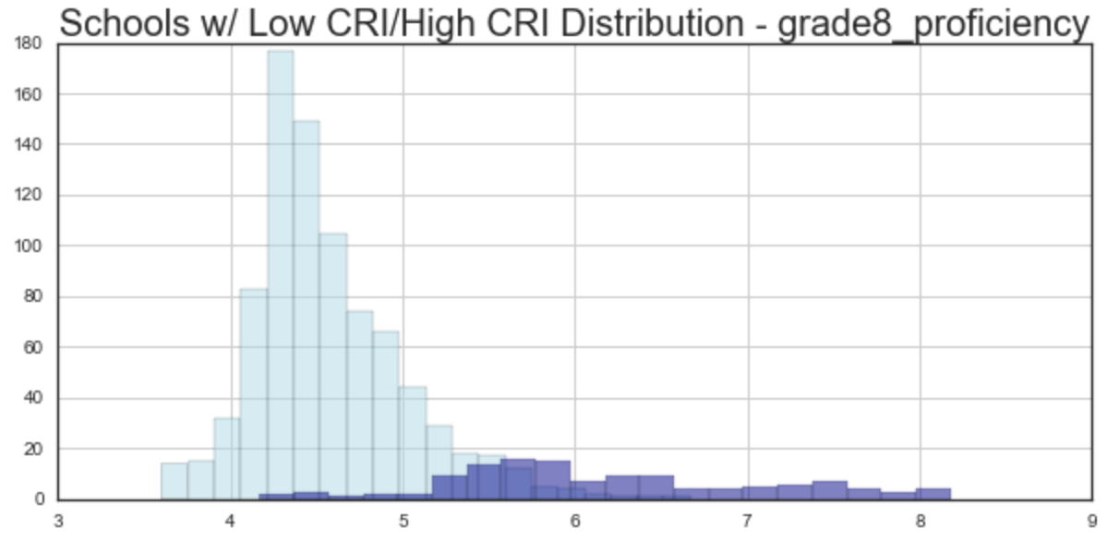
Observations (cont’d)
Median=Dataset: 83% | Low CRI: 84% | High CRI: 66%
Median=Dataset: 46% | Low CRI: 51% | High CRI: 22%
Median=Dataset: 50% | Low CRI: 52% | High CRI: 37%
(25%=Most Diversity | 100% = Least Diversity)
Median=Dataset: 30% | Low CRI: 32% | High CRI: 14%
Median=Dataset: 88% | Low CRI: 87% | High CRI: 95%
Key: = Schools with Low CRI
= Schools with High CRI
Median=Dataset: 8% | Low CRI: 8% | High CRI: 0.4%
Median=Dataset: 4.5 | Low CRI: 4.5 | High CRI: 6

Slide 10

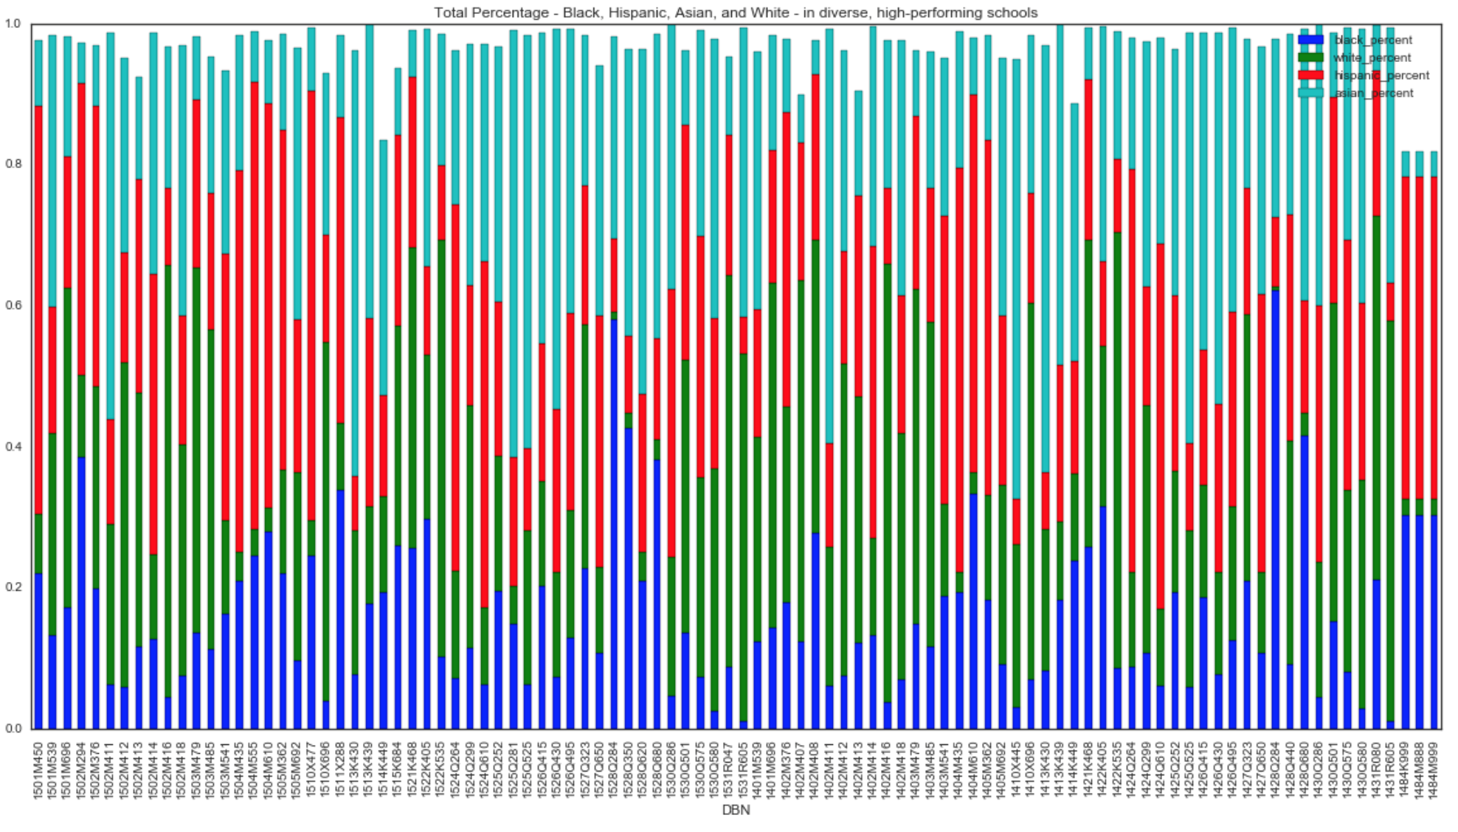

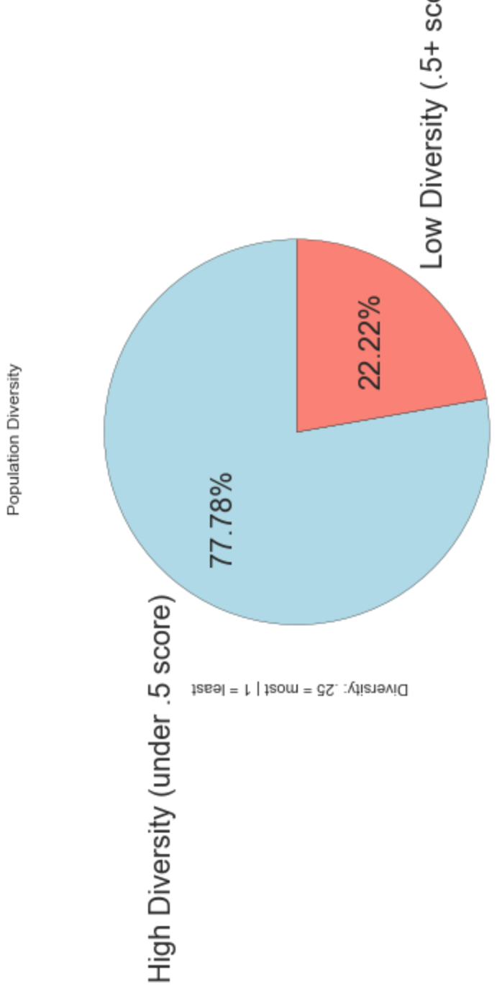


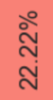



Observations (cont’d)
Population Diversity in High-Performing Schools

Slide 11
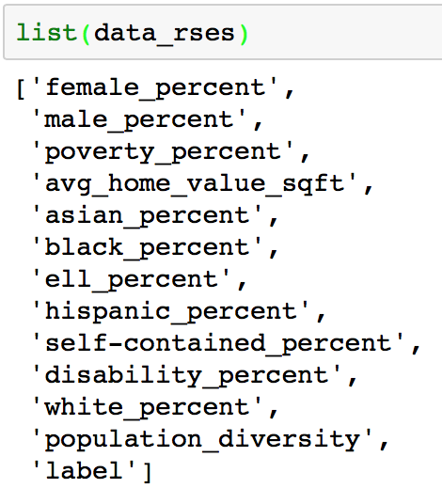
MODELING
Minimum Benchmark using Dummy Classifier:
Random Forest
Protect against overfitting (great because I have a considerable amount of features)
Will tell me most important features (which I can feed into other models)
Logistic Regression
Lasso/ridge will drop/let me know unimportant features
Will allow me to view feature coefficients
k-means Clustering:
I may be able to discover distinguishable groups of schools to find some counterintuitive combinations of characteristics as well as obvious ones
Precision | Recall | F1-Score
.79 | .81 | .80

Slide 12
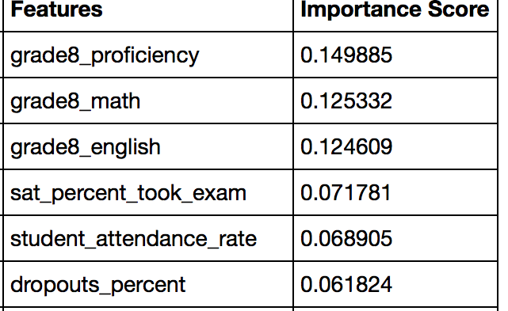
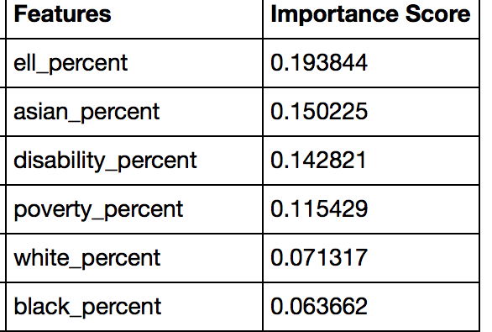
MODELING – Random Forest
RESULTS:
Three out of the four datasets beat the dummy classifier
data_rses (with student demographics/characteristics)
is worst-performing
data_noexam (which has no geographic info)
is marginally best-performing
 | Precision | Recall | Dummy Classifier F1-Score | F1-Score | % Change | Time
data_noexam | .86 | .86 | .80 | .86 | +7.5% | 3.99 ms per loop
data_admin | .86 | .86 | .80 | .86 | +7.5% | 4.42 ms per loop
data_zip | .82 | .86 | .80 | .84 | +5% | 17.3 ms per loop
data_rses | .64 | .82 | .80 | .72 | -10% | 2.87 ms per loop

Slide 13
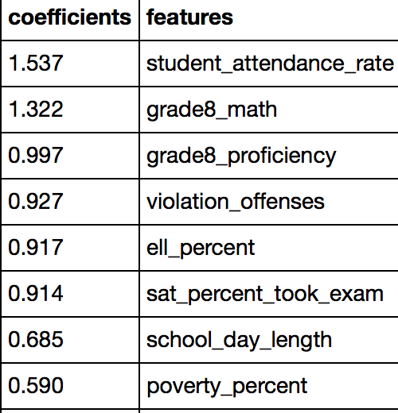
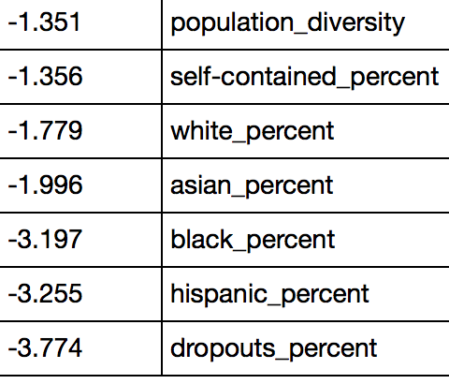
MODELING – Logistic Regression
RESULTS:
Logistic Regression was not as successful as Random Forest
Large amount of features in data_admin and data_zip made LR prohibitive
 | Precision | Recall | Dummy Classifier F1-Score | F1-Score | % Change | Time
data_noexam | .82 | .86 | .80 | .84 | +5% | 47.7 Microsecs per loop
data_admin | - | - | - | - | - | -
data_zip | - | - | - | - | - | -
data_rses | .60 | .76 | .80 | .67 | -16% | 44.8 Microsecs per loop

Slide 14
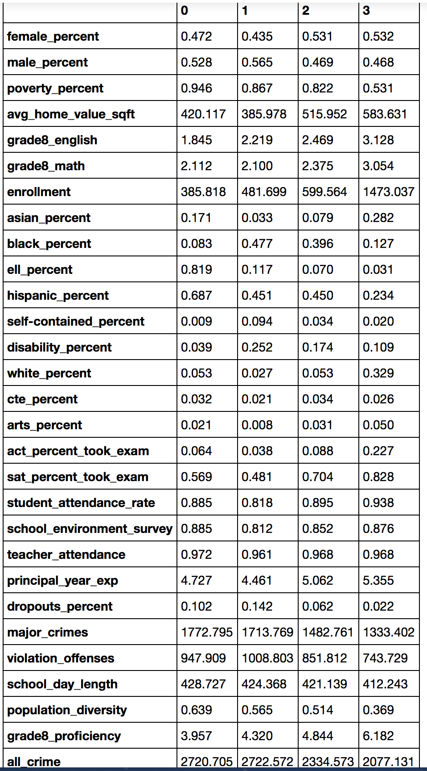
MODELING – k-means
Cluster 0 – A Challenging Start
Low Grade 8 Proficiency Scores
High Hispanic Percentage and ELL rates
High population diversity index, suggesting low diversity
High Poverty percentage
High crime areas
Small schools
Cluster 1 – Difficulty Staying On Track
Large disability percentage rates
Low attendance and test-taking rates
High drop-out rates and percentage of black students
Cluster 2 – On the Right Track
Despite poverty figure, schools appear to be in wealthy neighborhoods
Slightly above average testing scores
Slightly above avg diversity index, suggesting slightly low diversity
Presents similarly like cluster1 for race/ethnicity but with slightly smaller numbers, but has better testing, attendance, and dropouts
Cluster 3 – Large and High-Achieving
Large Asian population (Mean of entire dataset: 9%), so overrepresentation in this cluster → same with white percent
Low population diversity index, suggesting high diversity
High Grade 8 Proficiency scores

Slide 15
CHALLENGES/SUCCESSES
CHALLENGES:
Putting together different so many different datasets
Realized late in the process that I had forward-looking features that previously were artificially boosting my score
Removing them significantly decreased model performance
Wasted time running models I couldn’t use
Datasets I tested with geographic dummy categoricals had so many features that Logistic Regression wouldn’t run
SUCCESSES:
Interesting exploration and important features for insights
Some models beat benchmarks

Slide 16

conclusions
INSIGHTS:
While students who belong to historically marginalized groups also appear less frequently in schools with high college readiness rates, their presence alone is not an accurate predictor of whether a school has a high or low rate of college readiness.
Although schools with high college-readiness rates appear to have higher amounts of diversity (or dispersion) than schools with low rates of college readiness, this feature did not score highly on RF’s Feature Importance nor as a coefficient for LR.
Grade 8 Proficiency seems to be one of strongest predictive factors for college readiness
FUTURE STEPS:
Clustering with geographic data
More exploration
Complete similar work but on middle/elementary schools
What contributes to those Grade 8 Proficiency scores?
Compare data over several years as more is released

